Slide 1
Topics Covered:
Is there a relationship between x and y?
What is the strength of this relationship
Pearson’s r
Can we describe this relationship and use this to predict y from x?
Regression

Slide 2
The relationship between x and y
Correlation: is there a relationship between 2 variables?
Regression: how well a certain independent variable predict dependent variable?

Slide 3
Correlation
Correlation: The degree of relationship between the variables under consideration is measure through the correlation analysis.
The measure of correlation called the correlation coefficient .
The degree of relationship is expressed by coefficient which range from correlation ( -1 ≤ r ≥ +1)
The direction of change is indicated by a sign.
The correlation analysis enable us to have an idea about the degree & direction of the relationship between the two variables under study.

Slide 4
Correlation
Correlation is a statistical tool that helps to measure and analyze the degree of relationship between two variables.
Correlation analysis deals with the association between two or more variables.

Slide 5
Correlation & Causation
Causation means cause & effect relation.
Correlation denotes the interdependency among the variables for correlating two phenomenon, it is essential that the two phenomenon should have cause-effect relationship, if such relationship does not exist then the two phenomenon can not be correlated.
If two variables vary in such a way that movement in one are accompanied by movement in other, these variables are called cause and effect relationship.
Causation always implies correlation but correlation does not necessarily implies causation.

Slide 6
Types of Correlation Type I
Correlation
Positive Correlation
Negative Correlation

Slide 7
Types of Correlation Type I
Positive Correlation: The correlation is said to be positive correlation if the values of two variables changing with same direction.
Ex. Pub. Exp. & sales, Height & weight.
Negative Correlation: The correlation is said to be negative correlation when the values of variables change with opposite direction.
Ex. Price & qty. demanded.

Slide 8
Direction of the Correlation
Positive relationship – Variables change in the same direction.
As X is increasing, Y is increasing
As X is decreasing, Y is decreasing
E.g., As height increases, so does weight.
Negative relationship – Variables change in opposite directions.
As X is increasing, Y is decreasing
As X is decreasing, Y is increasing
E.g., As TV time increases, grades decrease
Indicated by
sign; (+) or (-).

Slide 9
More examples
Positive relationships
water consumption and temperature.
study time and grades.
Negative relationships:
alcohol consumption and driving ability.
Price & quantity demanded

Slide 10
Types of Correlation Type II
Correlation
Simple
Multiple
Partial
Total

Slide 11
Types of Correlation Type II
Simple correlation: Under simple correlation problem there are only two variables are studied.
Multiple Correlation: Under Multiple Correlation three or more than three variables are studied. Ex. Q_{d} = f ( P,P_{C}, P_{S}, t, y )
Partial correlation: analysis recognizes more than two variables but considers only two variables keeping the other constant.
Total correlation: is based on all the relevant variables, which is normally not feasible.

Slide 12
Types of Correlation Type III
Correlation
LINEAR
NON LINEAR

Slide 13
Types of Correlation Type III
Linear correlation: Correlation is said to be linear when the amount of change in one variable tends to bear a constant ratio to the amount of change in the other. The graph of the variables having a linear relationship will form a straight line.
Ex X = 1, 2, 3, 4, 5, 6, 7, 8,
Y = 5, 7, 9, 11, 13, 15, 17, 19,
Y = 3 + 2x
Non Linear correlation: The correlation would be non linear if the amount of change in one variable does not bear a constant ratio to the amount of change in the other variable.

Slide 14
Methods of Studying Correlation
Scatter Diagram Method
Graphic Method
Karl Pearson’s Coefficient of Correlation
Method of Least Squares

Slide 15
Scatter Diagram Method
Scatter Diagram is a graph of observed plotted points where each points represents the values of X & Y as a coordinate. It portrays the relationship between these two variables graphically.

Slide 16
Scattergrams
Y
Y
Y
Y
Y
Y
X
X
X
Positive correlation
Negative correlation
No correlation

Slide 17
A perfect positive correlation
Weight
Weight of B
Weight of A
A linear
relationship
Height
Height of A
Height of B

Slide 18
High Degree of positive correlation
Positive relationship
Weight
Height

Slide 19
Degree of correlation
Moderate Positive Correlation
Shoe Size
Weight

Slide 20
Degree of correlation
Perfect Negative Correlation
TV watching per
week
Exam score

Slide 21
Degree of correlation
Moderate Negative Correlation
TV watching per
week
Exam score

Slide 22
Degree of correlation
Weak negative Correlation
Shoe Size
Weight

Slide 23
Degree of correlation
No Correlation (horizontal line)
IQ
Height

Slide 24
2) Direction of the Relationship
Positive relationship – Variables change in the same direction.
As X is increasing, Y is increasing
As X is decreasing, Y is decreasing
E.g., As height increases, so does weight.
Negative relationship – Variables change in opposite directions.
As X is increasing, Y is decreasing
As X is decreasing, Y is increasing
E.g., As TV time increases, grades decrease

Slide 25
Advantages of Scatter Diagram
Simple & Non Mathematical method
Not influenced by the size of extreme item
First step in investing the relationship between two variables

Slide 26
Disadvantage of scatter diagram
Can not adopt the an exact degree of correlation

Slide 27
Karl Pearson's Coefficient of Correlation
Pearson’s ‘r’ is the most common correlation coefficient.
Karl Pearson’s Coefficient of Correlation denoted by- ‘r’ The coefficient of correlation ‘r’ measure the degree of linear relationship between two variables say x & y.

Slide 28
Karl Pearson's Coefficient of Correlation
Karl Pearson’s Coefficient of Correlation denoted by- r
-1 ≤ r ≥ +1
Degree of Correlation is expressed by a value of Coefficient
Direction of change is Indicated by sign
( - ve) or ( + ve)

Slide 29
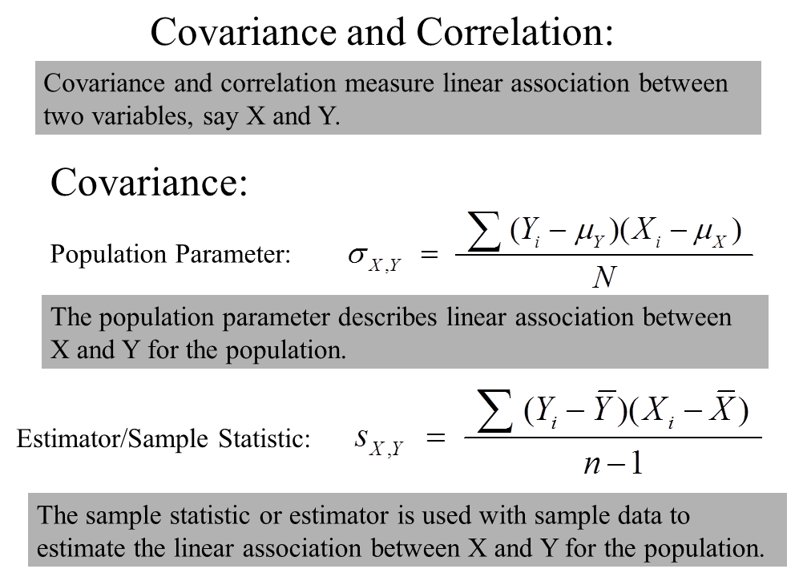

Slide 30
Example Covariance
x
y
x
−
x
y
−
y
(
x
−
x
)(
y
−
y
)
i
i
i
i
0
3
-
3
0
0
2
2
-
1
-
1
1
3
4
0
1
0
4
0
1
-
3
-
3
6
6
3
3
9
x
=
3
y
=
3
∑
=
7
What does this number tell us?

Slide 31
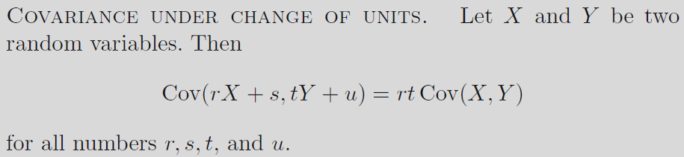
The covariance changes under a change of units
The covariance Cov(X,Y) may not always be suitable to express the dependence between X and Y. For this reason, there is a standardized version of the covariance called the correlation coefficient of X and Y, which remains unaffected by a change of units and, therefore, is dimensionless.

Slide 32
Converting covariance to correlation
Knowing that the covariance of two variables is positive is useful as it indicates that as one increases, so does the other
But, the actual value of covariance is dependent up the measurement units of the variables
but the real strength of the relationship is the same
because the covariance is dependent upon the measurement units used it is hard to interpret unless we first standardize it.
Notes:
Conversion of covariance to a correlation coefficient is analogous to making the variance more useful by taking the square root of it to convert into the SD, which is in the same units as the original DV

Slide 33
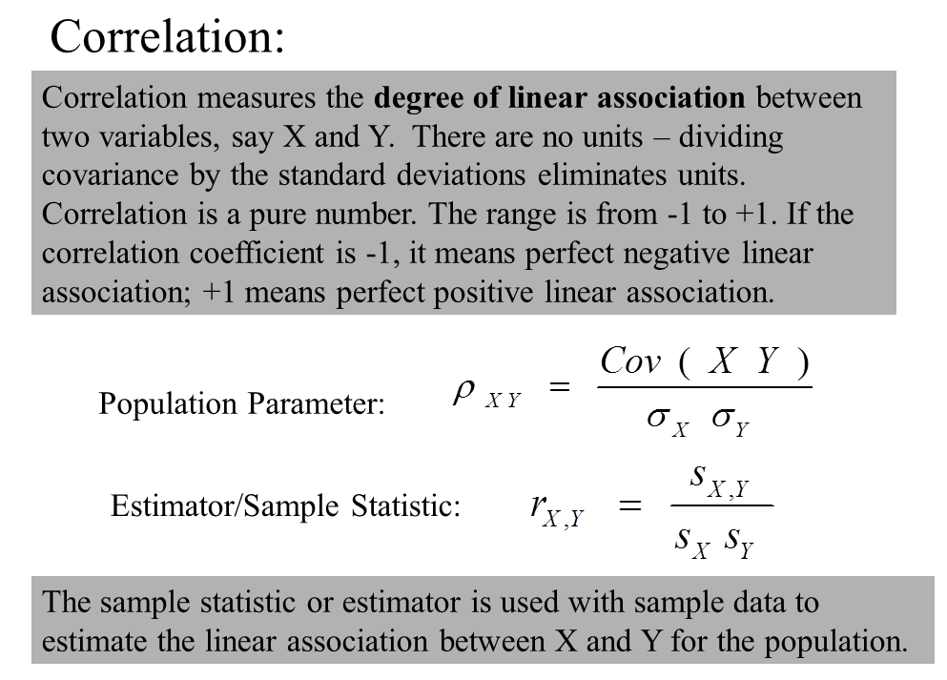

Slide 34
Smoking v Lung Capacity Data
N | Cigarettes (X ) | Lung Capacity (Y )
1 | 0 | 45
2 | 5 | 42
3 | 10 | 33
4 | 15 | 31
5 | 20 | 29

Slide 35
Smoking and Lung Capacity

Slide 36
Calculating Covariance
Cigs (X ) | Lung Cap (Y )
0 | 45
5 | 42
10 | 33
15 | 31
20 | 29
10 | 36

Slide 37
Calculating Covariance
Cigs (X ) |  |  |  | Cap (Y )
0 | -10 | -90 | 9 | 45
5 | -5 | -30 | 6 | 42
10 | 0 | 0 | -3 | 33
15 | 5 | -25 | -5 | 31
20 | 10 | -70 | -7 | 29
 |  | ∑= -215

Slide 38
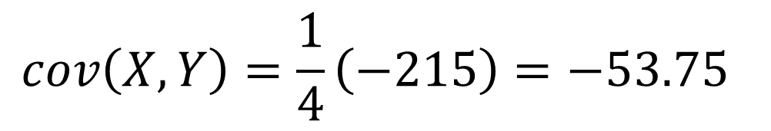
Covariance Calculation
Evaluation yields,
$$cov\left(X,Y\right)=\frac{1}{4}\left(−215\right)=−53.75$$

Slide 39
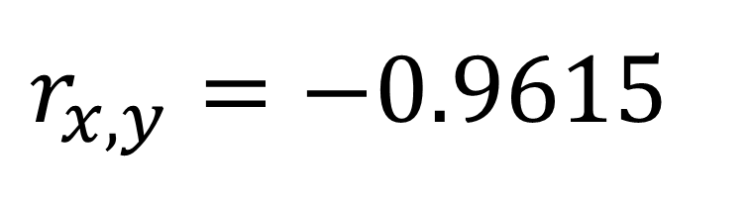
Computing Correlation
$$r_{x,y}=−0.9615$$

Slide 40
Interpretation of Correlation Coefficient (r)
The value of correlation coefficient ‘r’ ranges from -1 to +1
If r = +1, then the correlation between the two variables is said to be perfect and positive
If r = -1, then the correlation between the two variables is said to be perfect and negative
If r = 0, then there exists no correlation between the variables

Slide 41
Assumptions of Pearson’s Correlation Coefficient
There is linear relationship between two variables, i.e. when the two variables are plotted on a scatter diagram a straight line will be formed by the points.
Cause and effect relation exists between different forces operating on the item of the two variable series.

Slide 42
Advantages of Pearson’s Coefficient
It summarizes in one value, the degree of correlation & direction of correlation also.

Slide 43
Limitation of Pearson’s Coefficient
Always assume linear relationship
Interpreting the value of r is difficult.
Value of Correlation Coefficient is affected by the extreme values.
Time consuming methods

